Slide 1

Neuroengineering & Biomedical Instrumentation Lab
Brain Computer Interfaces & Neuroprostheses
Dr. Nitish Thakor
Luke Osborn, Joseph Betthauser, Sapna Kumar, Chris Hunt, Mark Iskarous
November 30, 2017

Slide 2
Prosthetic Arms
Notes:
Common commercial limbs are controlled with electromyography (EMG) signals….they also lack tactile sensors

Slide 3
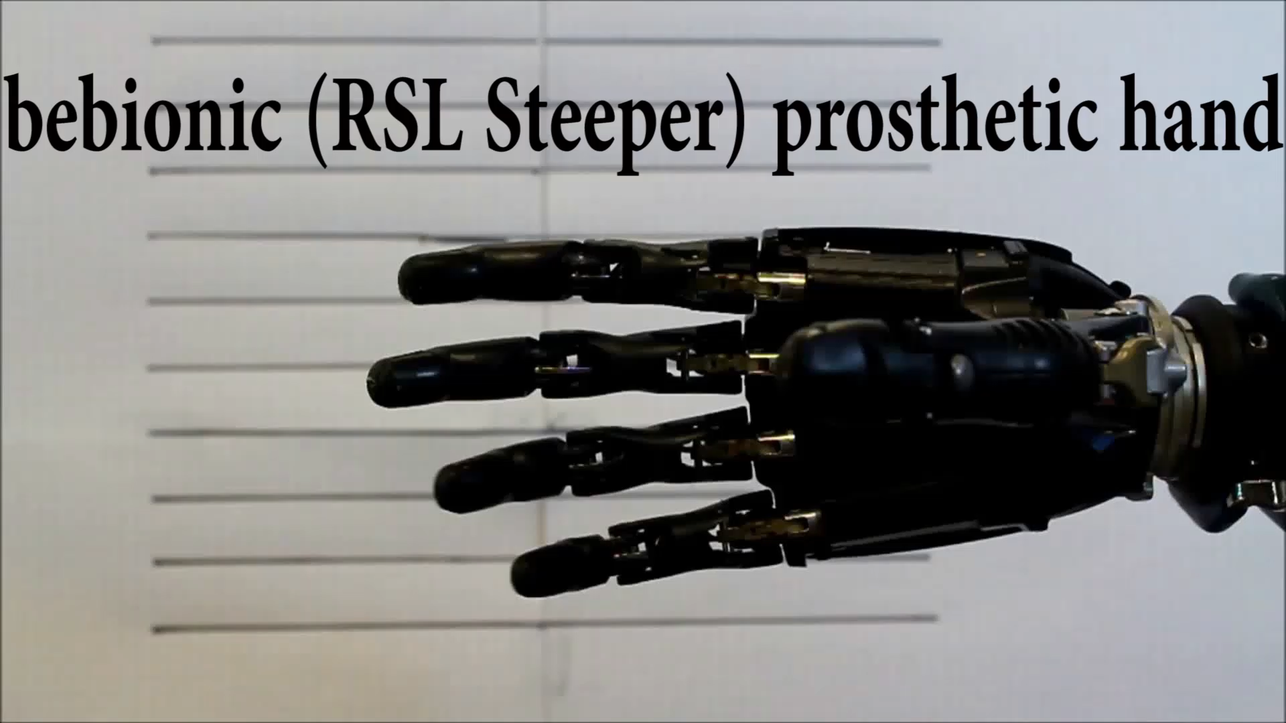
Hands Without Feeling
Notes:
Need tactile feedback

Slide 4
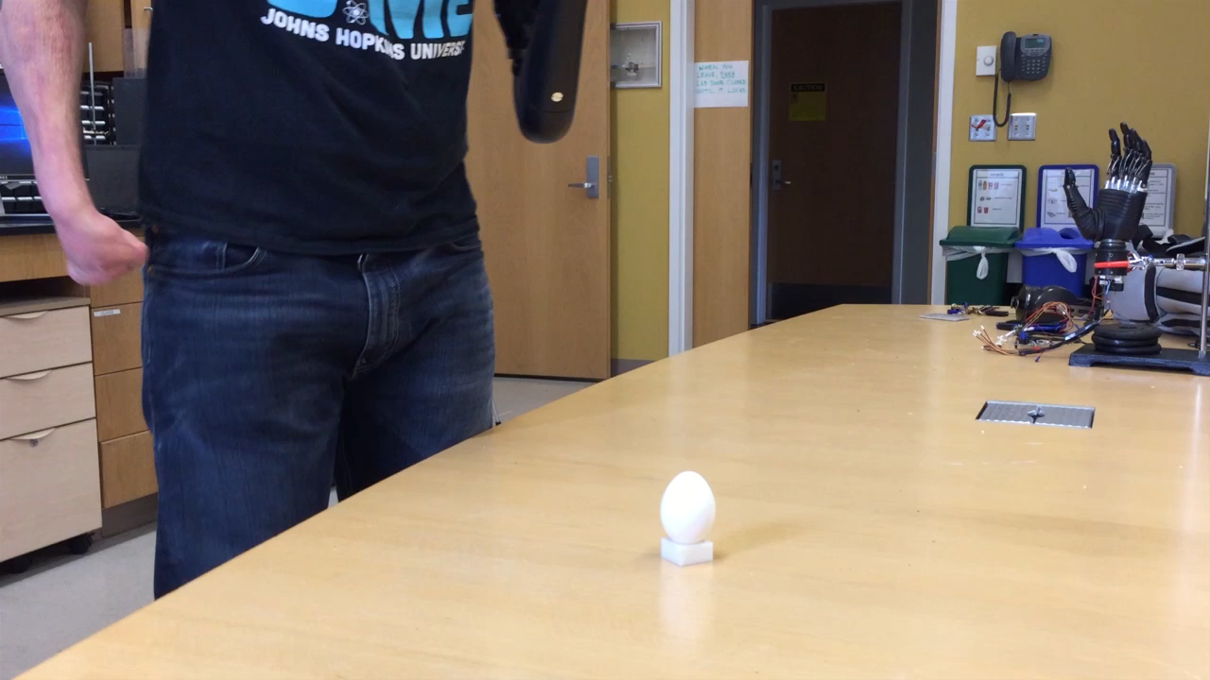
The Future
Notes:
Moving forward – our goal is to incorporate targeted nerve stimulation with the known effects of perception and the neuromorphic representation of touch to continue improving how amputees use their prostheses and make them more intuitive and functional.

Slide 5
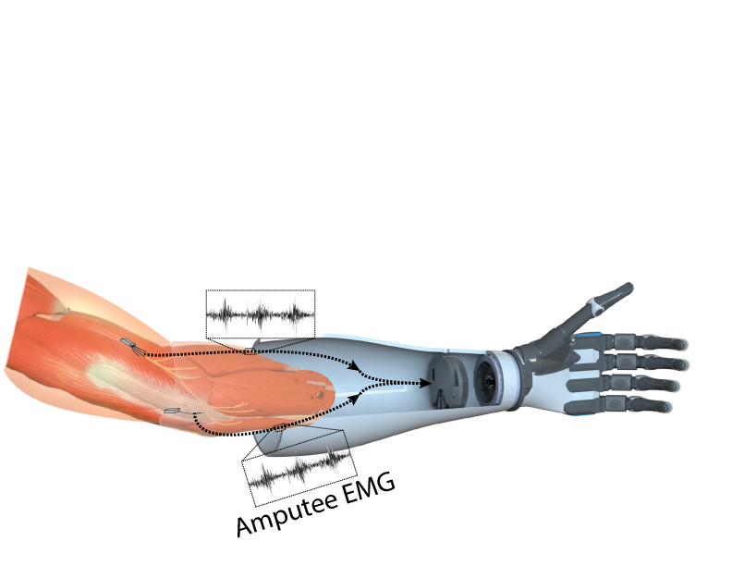
Prosthetic Arm
Socket
EMG Electrodes
Hand

Slide 6
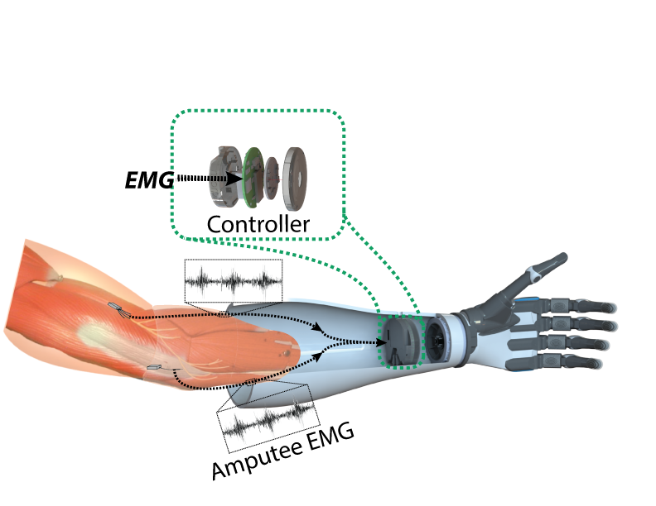
Prosthesis Control

Slide 7
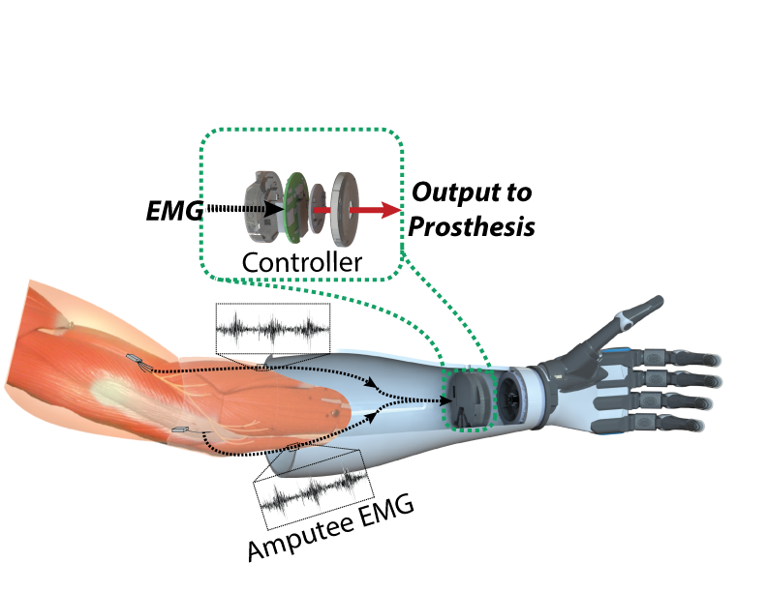
Prosthesis Control
Notes:
Explain how the hand is controlled

Slide 8
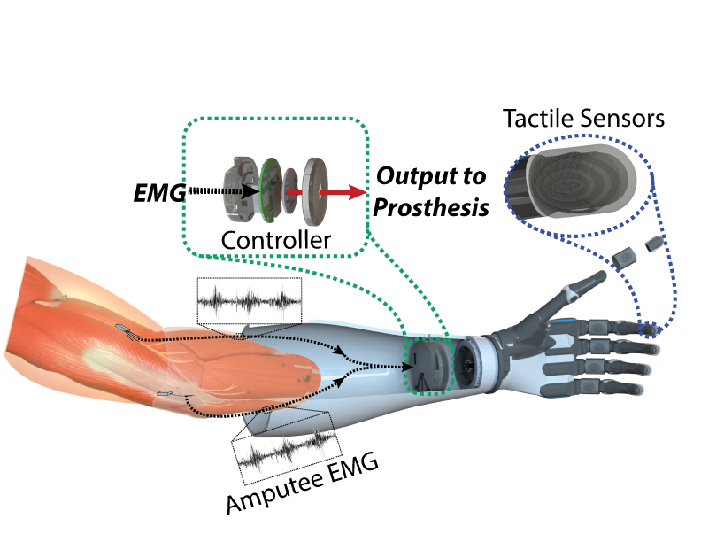
Tactile Feedback
Osborn et al, Trans on Haptics, 2016

Slide 9

Tactile Feedback
Osborn et al, Trans on Haptics, 2016

Slide 10
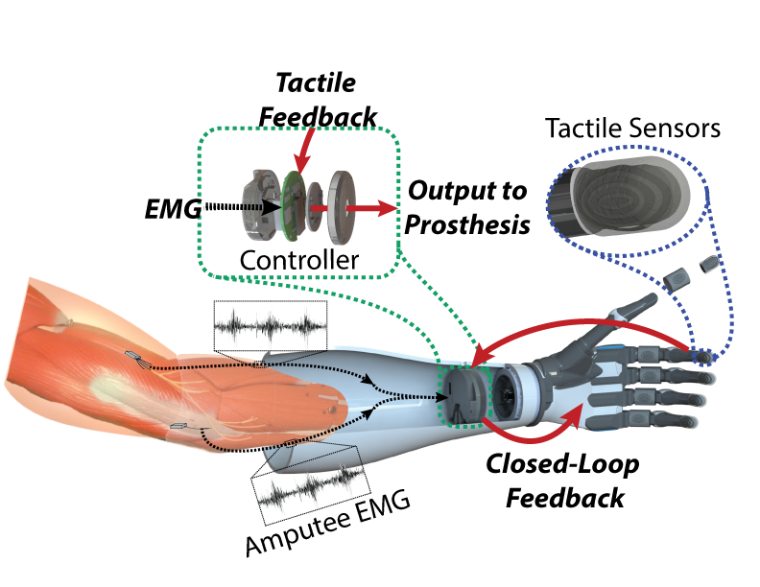
Tactile Feedback
Osborn et al, Trans on Haptics, 2016
Notes:
So now, these sensors can interface with the prosthesis controller to provide feedback and improve grasping

Slide 11
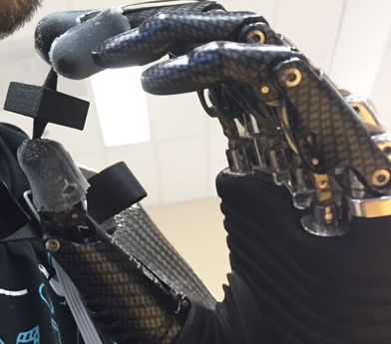
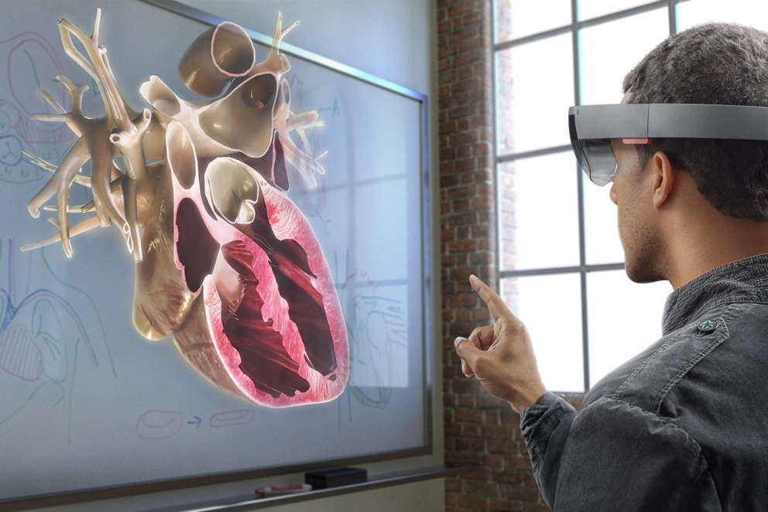
Demos
Tactile Feedback (Mark)
Prosthesis Control (Luke)
Pattern Recognition (Joseph)
High Density EMG Electrodes (Sapna)
Augmented Reality Prosthesis (Chris)

